Slide 1



Basics of DNS

Slide 2


What is DNS ?
DNS- Domain Name System
Solves the method of converting Numeric IP addressing to Human Readable friendly URL and vice versa
Acts like a phone book/contact directory , maintain the name of the person against numbers
192.168.100.200 <--------> www.example.com
||
www.example.com <-------> 192.168.100.200
DNS Server
Where is the IP for google.com
192.100.100.100

Slide 3



How DNS work?
(.) Root Server
Top Level Domain Server
3
.com
.gov
.net
.org
Internal DNS server
2
5
4
1
6
www
mail
Authoritative DNS servers for mysimplepage.com
You type www.mysimplepage.com.

Slide 4
DNS RECORD TYPES
DNS have many records but following record are commonly used
A Record
CNAME Record
Alias Records

Slide 5
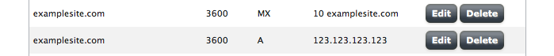
A record
An A record maps a domain name to the IP address (IPv4) and AAAA maps to IPv6 for computer hosting the domain
Ex: When you visit a website, you enter www.mysimplepage.com.
At name server there is an A record that points to the IP address 202.83.54.213.
This means that a request from your browser to www.mysimplepage.com. is directed to the server with IP address 202.83.54.213
Notes:
An A record maps a domain name to the IP address (IPv4) of the computer hosting the domain.
Simply put, an A record is used to find the IP address of a computer connected to the internet from a name.
The A in A record stands for Address.
Whenever you visit a web site, send an email, connect to Twitter or Facebook or do almost anything on the Internet,
the address you enter is a series of words connected with dots.
For example, to access the mysimplepage website you enter www.mysimplepage.com. At our name server there is an A record that points to the IP address 208.93.64.253.
This means that a request from your browser to www.mysimplepage.com is directed to the server with IP address 208.93.64.253.
A Records are the simplest type of DNS records, yet one of the primary records used in DNS servers.
You can actually do quite a bit more with A records, including using multiple A records for the same domain in order to provide redundancy.
Additionally, multiple names could point to the same address, in which case each would have its own A record pointing to the that same IP address.

Slide 6
CNAME record
CNAME stands for Canonical Name
A CNAME records is used to alias one name to another
A CNAME (Canonical Name) points one domain or subdomain to another domain name, allowing you to update one A Record each time you make a change, regardless of how many Host Records need to resolve to that IP address
mobile.mysimplepage.com CNAME www.mysimplepage.com
m.mysimplepage.com CNAME www.mysimplepage.com
www.mysimplegpage.com A 202.83.54.213.

Slide 7
NS records
A NS records specifies authoritative name-servers for the registered domain
Ex:
mysimplepage.com. NS ns1.mysimplepage.com.
mysimplepage.com. NS ns2.mysimplepage.net.
mysimplepage.com. NS ns3.mysimplepage.org.
mysimplepage.com. NS ns4.mysimplepage.co.in.
ns1.mysimplepage.net. A 202.83.54.213
ns2.mysimplepage.org. A 202.83.54.214
ns3.mysimplepage.co.in. A 202.83.54.215

Slide 8
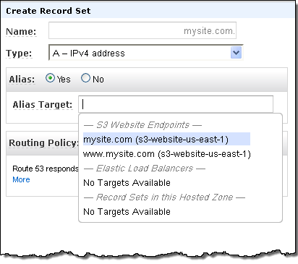
ALIAS record
AWS offers Alias records, which are to map resource record sets in AWS hosted zone
Mapped AWS resources include ELB, CloudFront distributions, Elastic Beanstalk environments, or S3 buckets that are configured as websites
Alias records work like a CNAME record in that you can map one DNS name (mysimplepage.com) to another ‘target’ DNS name (elb111222.elb.amazonaws.com)
They differ from a CNAME record in that they are not visible to resolvers
Resolvers only see the A record and the resulting IP address of the target record

Slide 9
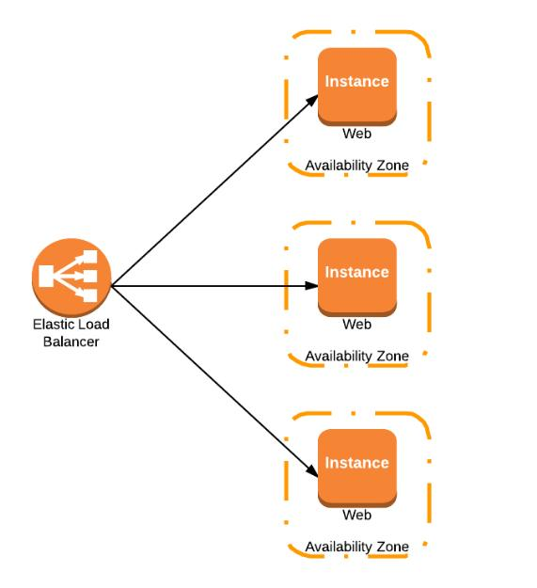

Why ALIAS record ?
www.mysimplepage.com
A 192.168.1.100
Amazon Route 53
A 192.168.1.110
elb111222.elb.amazonaws.com
A 192.168.1.120
www.mysimplepage.com ALIAS elb111222.elb.amazonaws.com A 192.168.1.100|192.168.1.110|192.168.1.120

Slide 10
Thank You

